Slide 1
2019 CABQ IPRA Data and Compliance Update

Slide 3
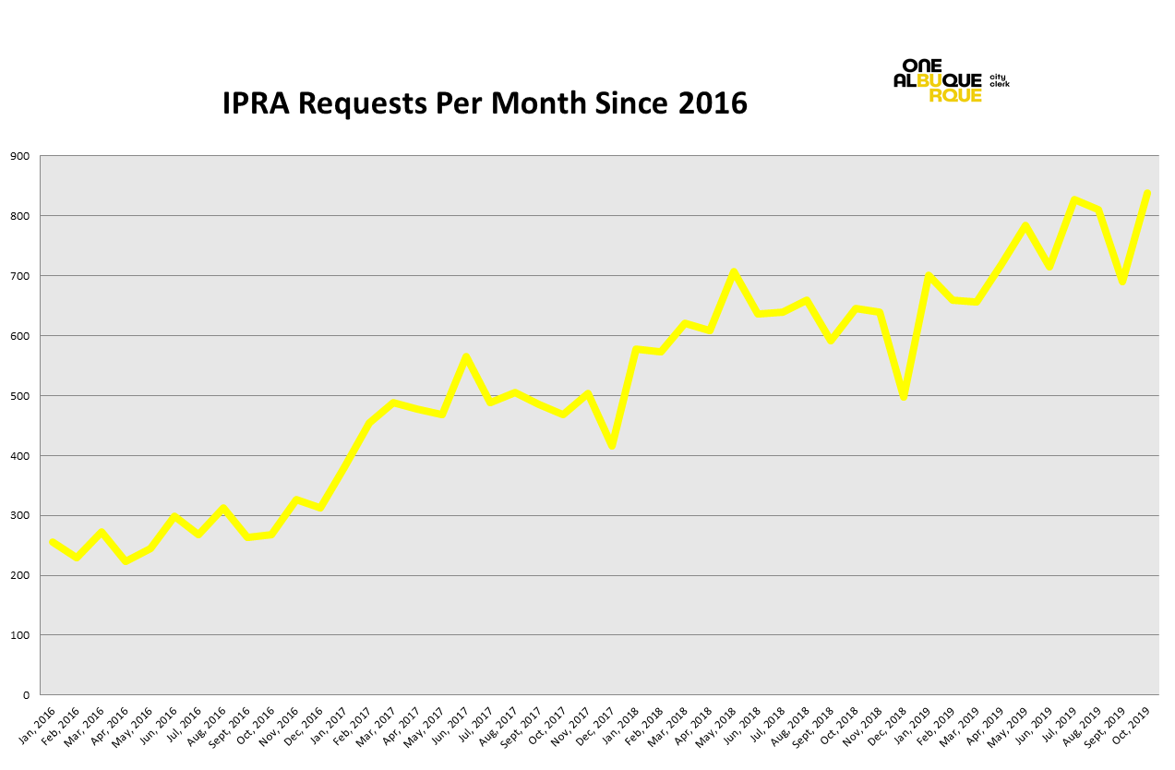

Slide 6
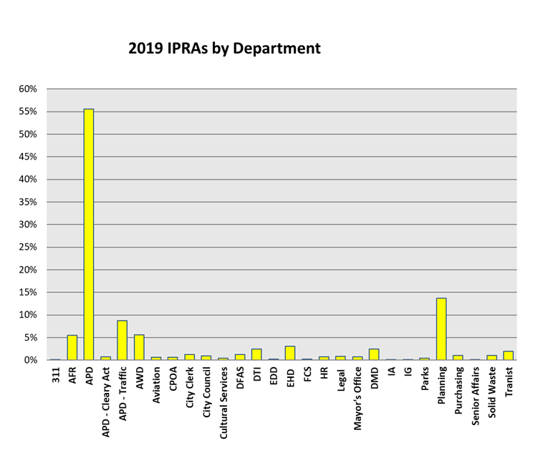

Slide 11
Who submits IPRA requests to CABQ?

Slide 12
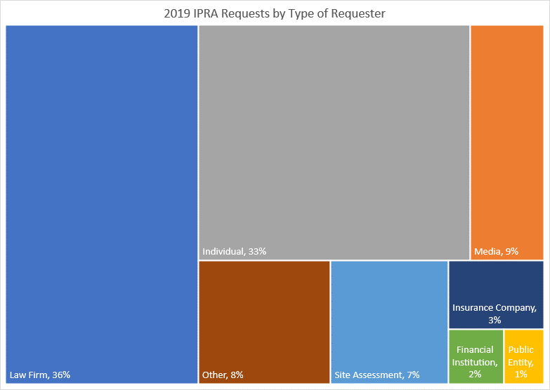

Slide 13
Changes to IPRA Processing

Slide 14
City Clerk IPRA Division
Old Model
Each department had a records custodian who responded to requests on behalf of a department.
One IPRA Specialist for multi-department requests.
New Model
4 IPRA Specialists in the Office of the City Clerk assigned to a department or group of departments.
6-7 IPRA Technicians who assist with processing requests for law enforcement records.

Slide 15
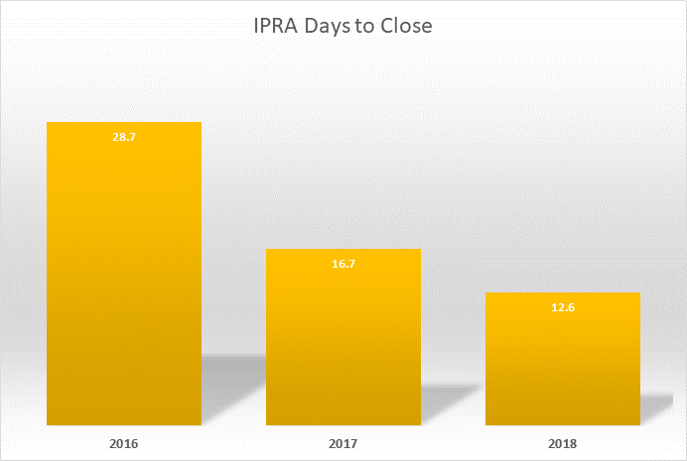
Change in response time

Slide 17
Open Data
“Understanding who requesters are and what the need is necessary for City officials to use limited resources effectively and efficiently for better government transparency”
Sunlight Foundation, October, 2018

Slide 18
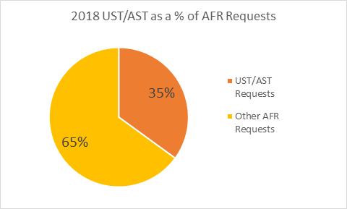
UST/AST

Slide 19
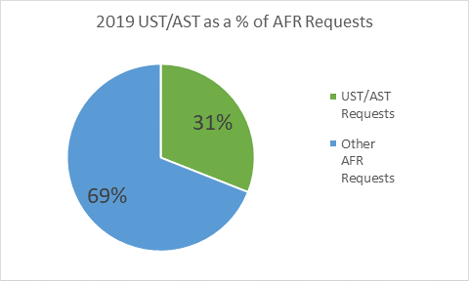
UST/AST

Slide 20
Other Open Records Projects
Contracts
Bids
Fire Code Inspection Reports
Emissions Inventory Reports

Slide 22
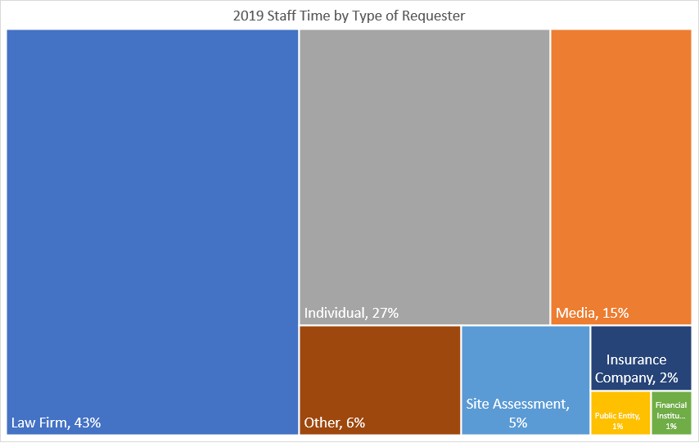

Slide 23
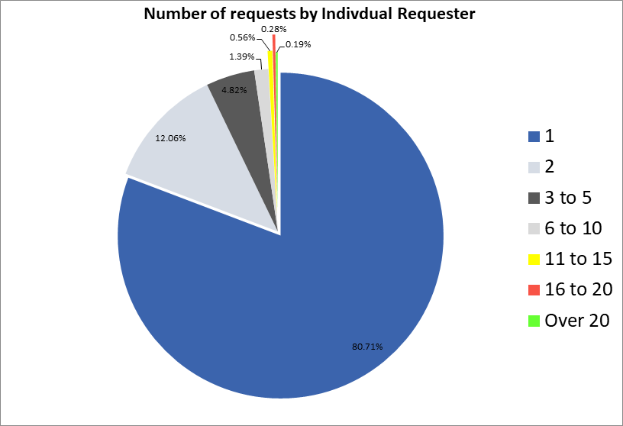

Slide 24
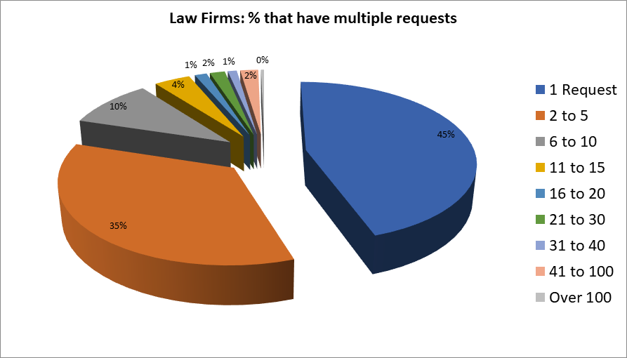

Slide 25
What is success?
What metrics matter?

Slide 26
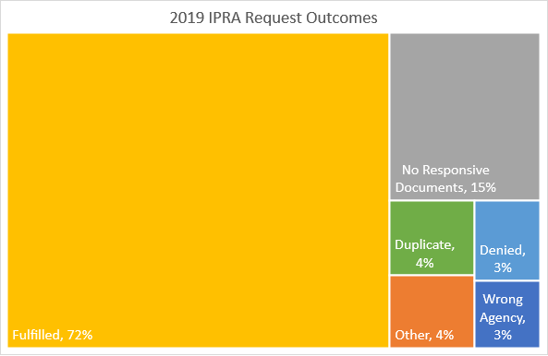

Slide 27
Questions?
Ethan Watson
Deputy City Clerk
(505)768-IPRA

